Slide 1
British Airways
Customer Review Analysis

Slide 2
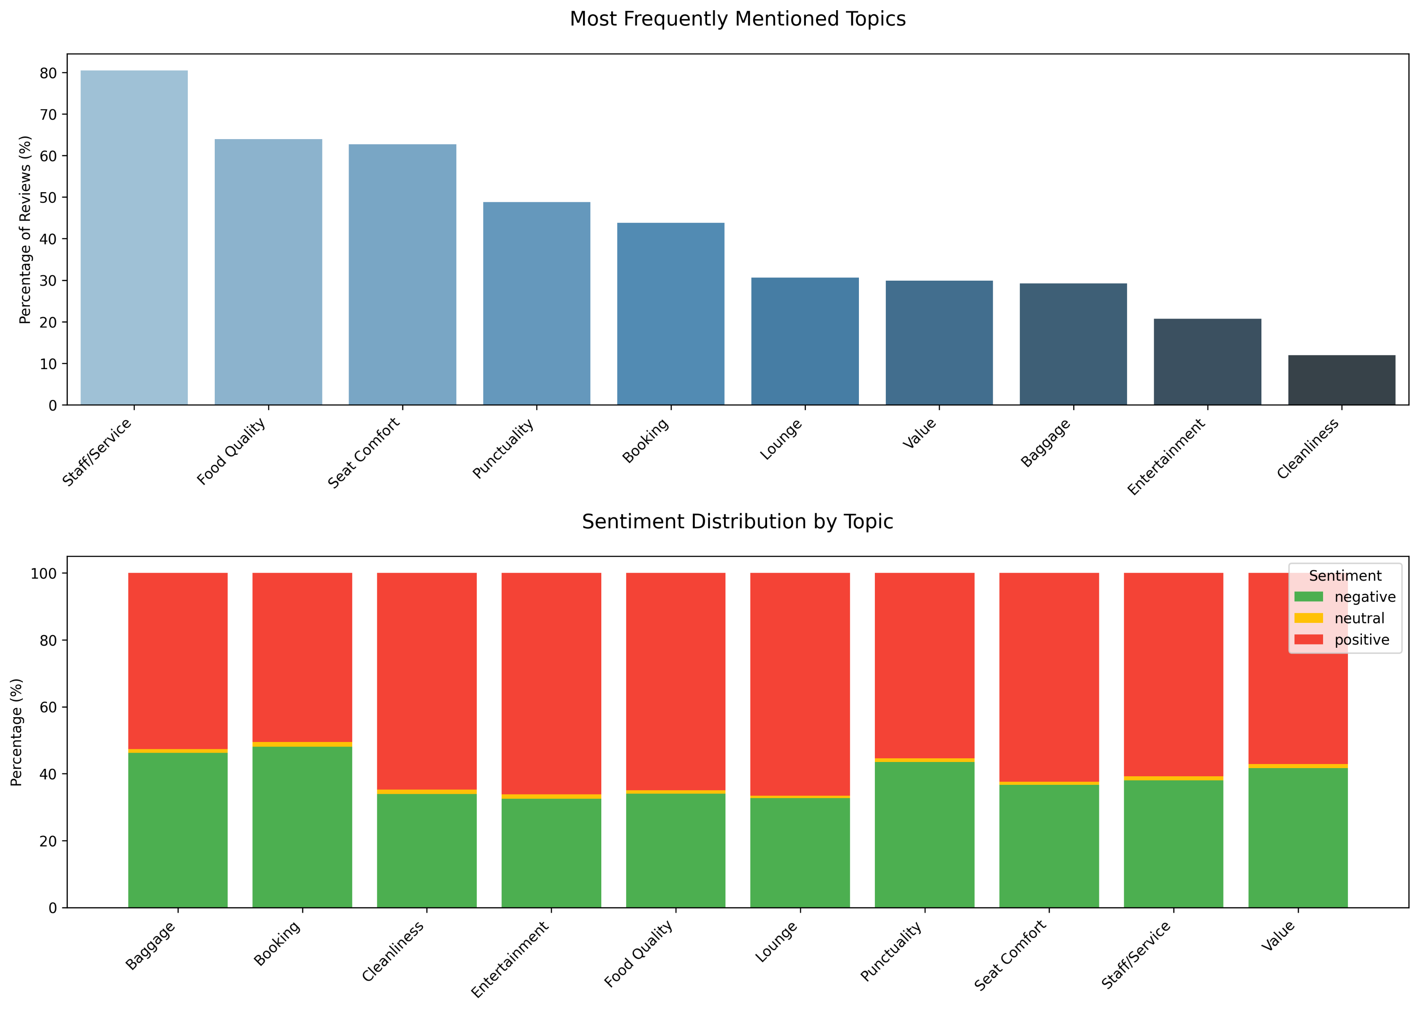
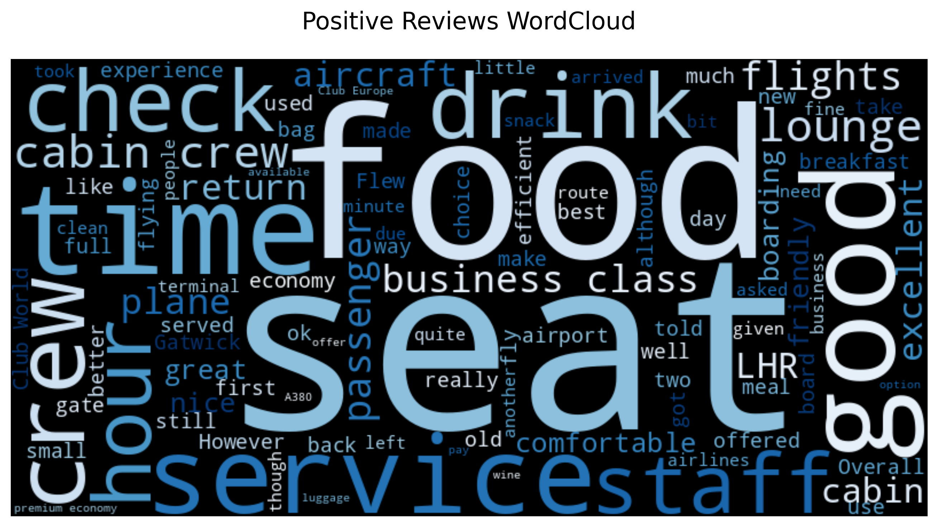
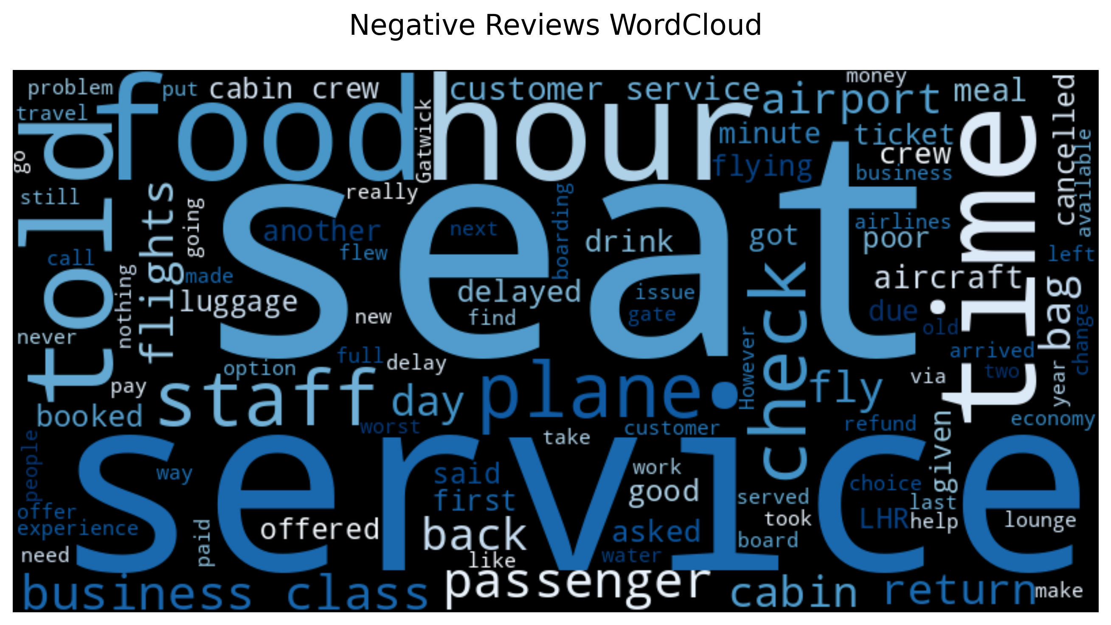
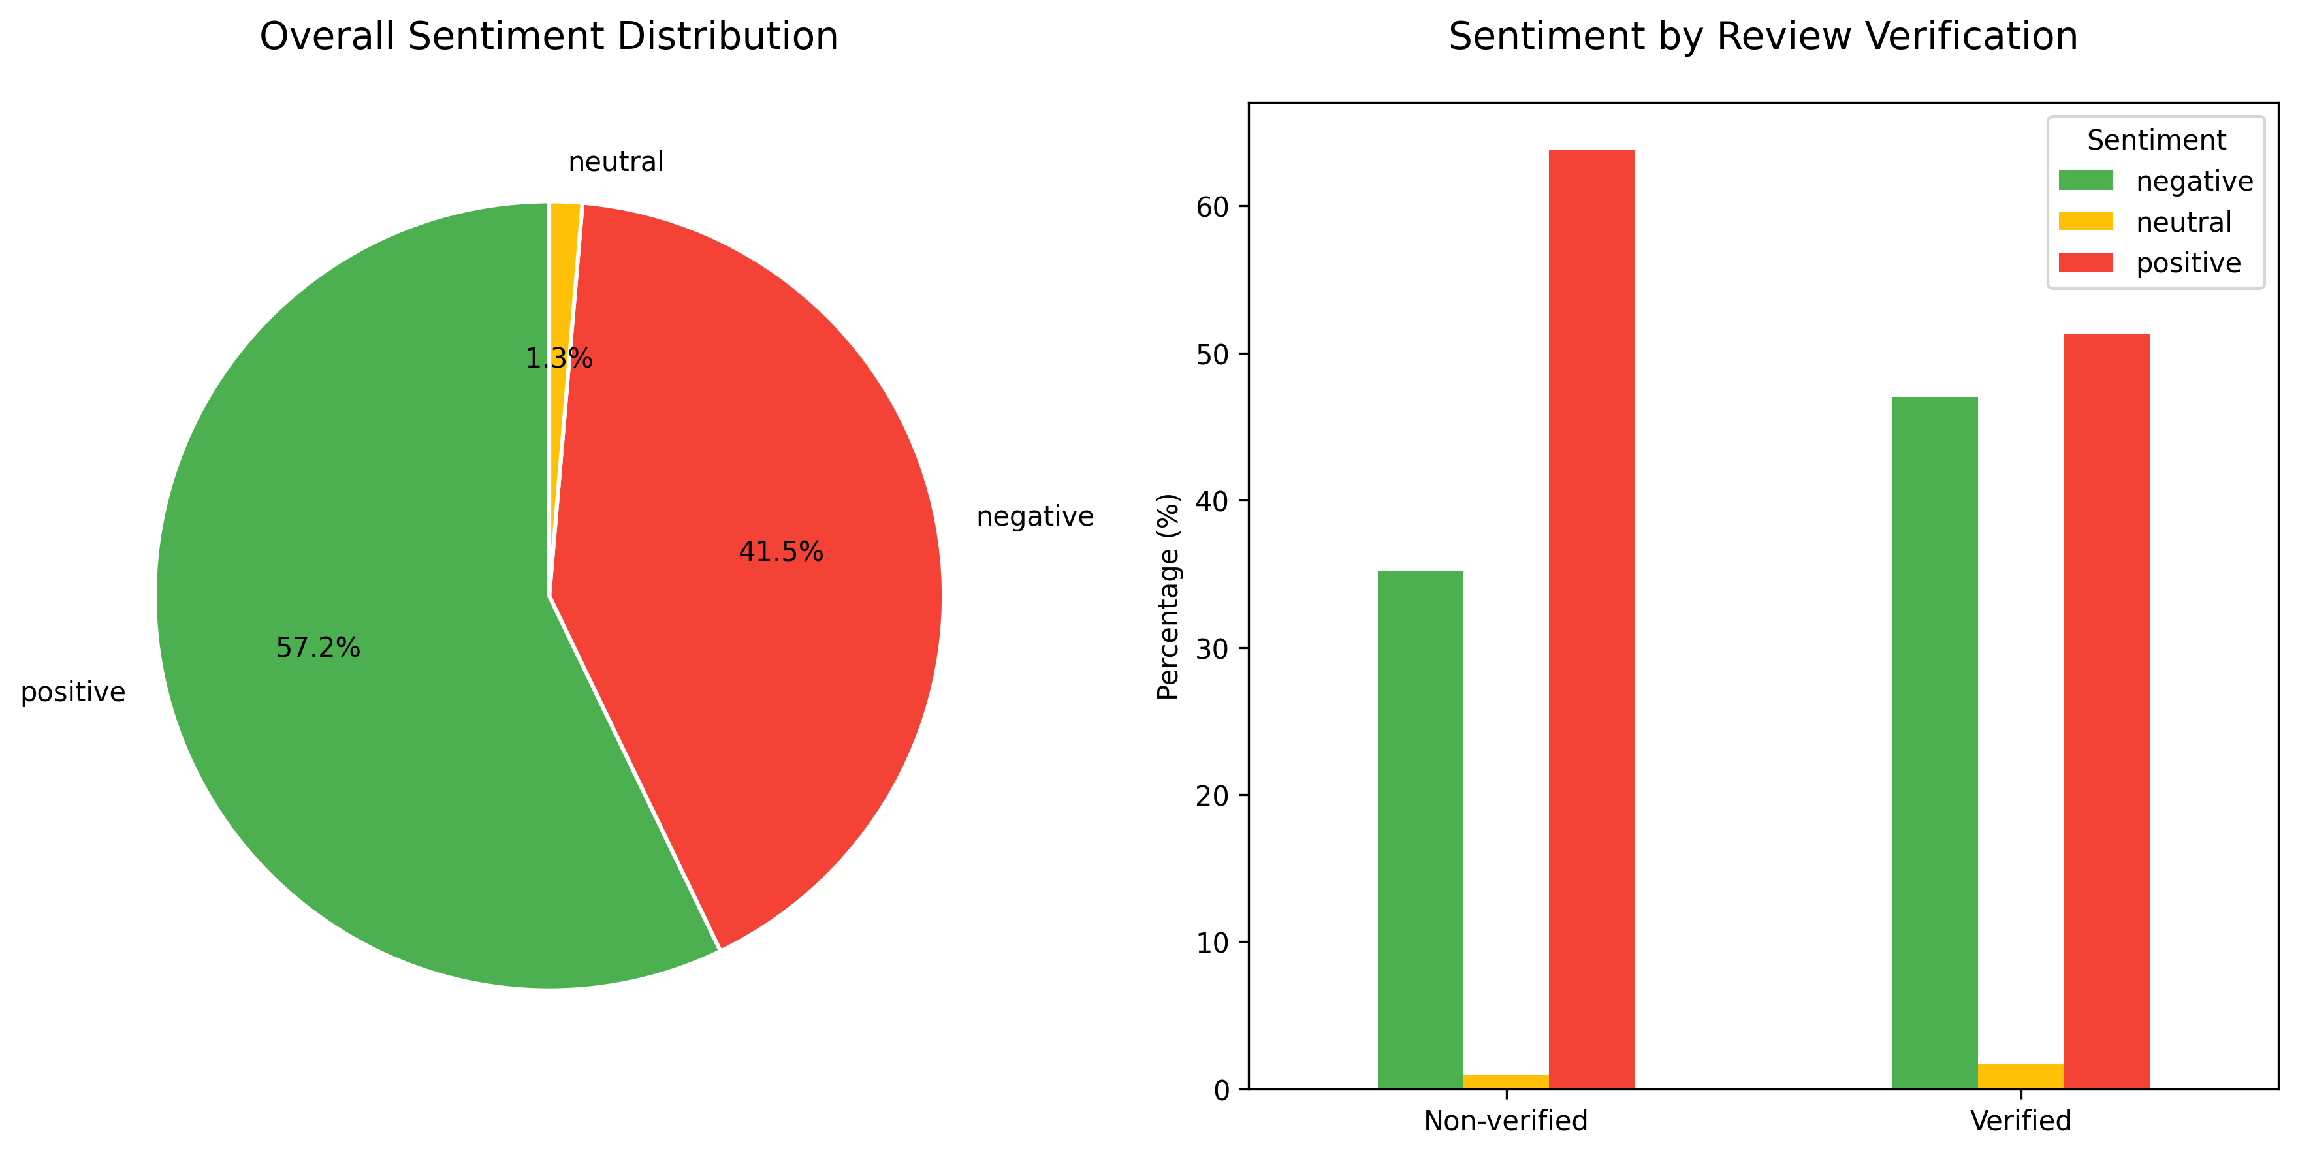
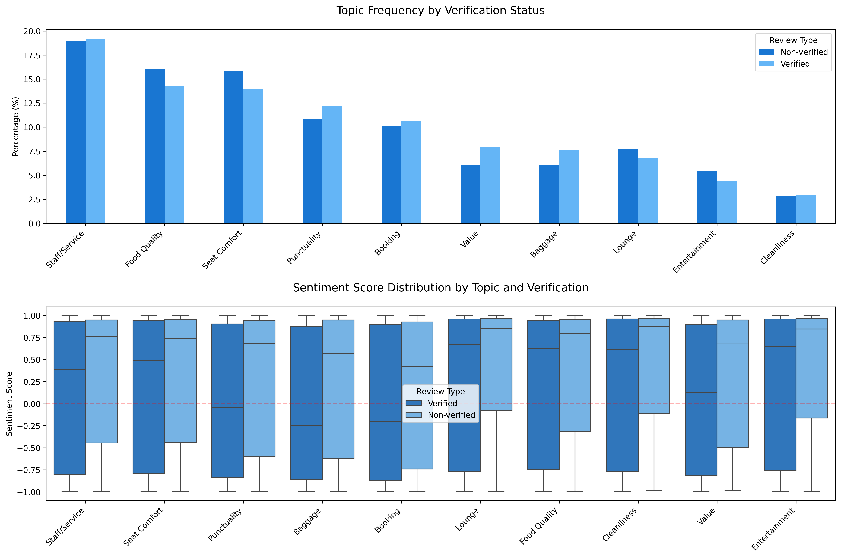
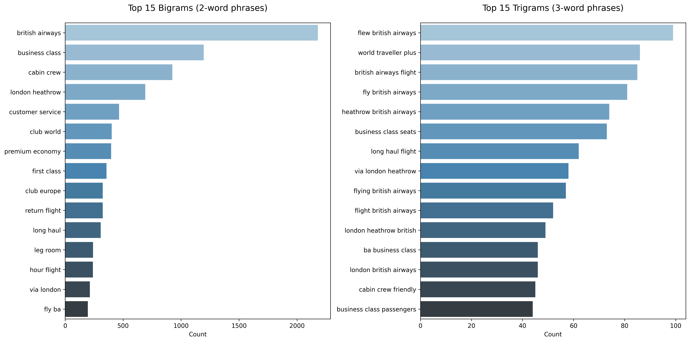
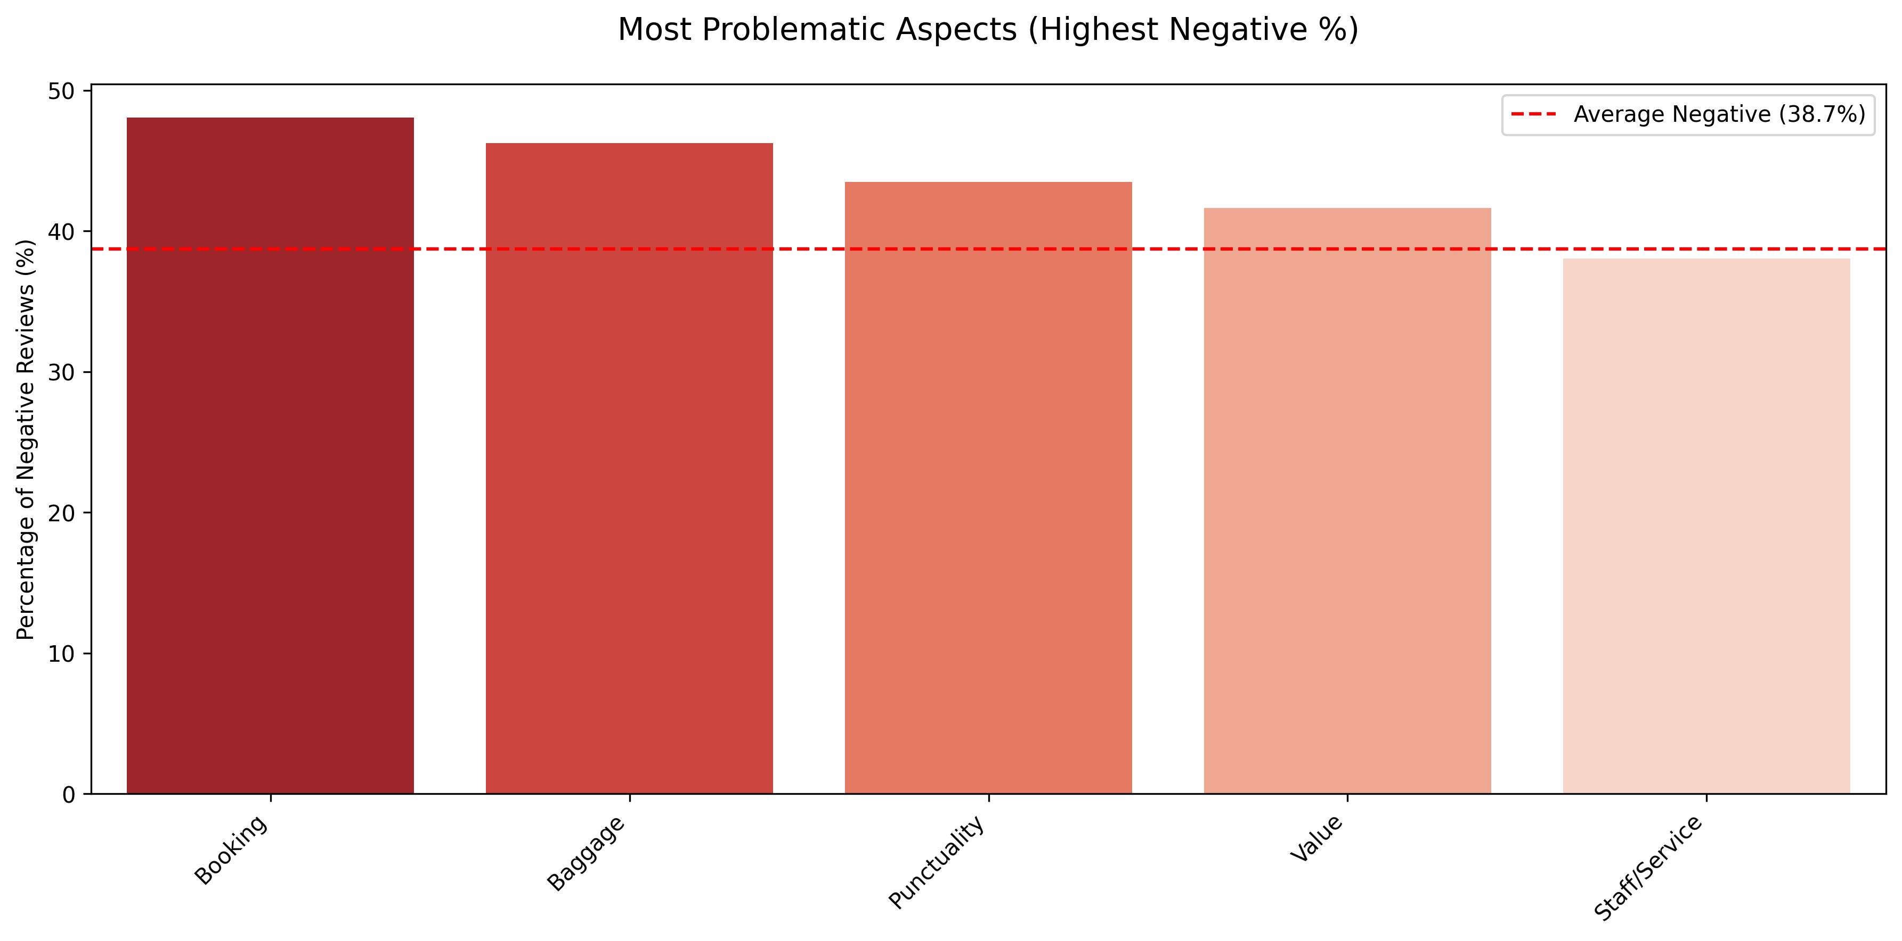
Customer Feedback Analysis
Total reviews analyzed: 3937
Verified reviews: 2096 (53.2%)
Non-verified reviews: 1841 (46.8%)
Overall Sentiment:
Positive: 57.2%
Negative: 41.5%
Neutral: 1.3%
Top 5 Most Mentioned Topics:
Staff/Service: 80.5% of reviews
Food Quality: 63.9% of reviews
Seat Comfort: 62.7% of reviews
Punctuality: 48.8% of reviews
Booking: 43.8% of reviews
Most Problematic Aspects (Highest Negative %): 1. Booking: 48.1% negative
2. Baggage: 46.3% negative
3. Punctuality: 43.5% negative
4. Value: 41.6% negative
5. Staff/Service: 38.0% negative
Verified vs Non-verified Sentiment Comparison: - Verified reviews positive: 51.3%
Non-verified reviews positive: 63.8%
Verified reviews negative: 47.0%
Non-verified reviews negative: 35.2%
Recommendations based on analysis:
Address punctuality issues and improve communication during delays
Evaluate pricing strategy to better align with perceived value
Standardize cleanliness protocols to ensure consistency
Improve seat comfort and in-flight entertainment options
Focus on verified customer feedback for targeted improvements

